Slide 1
Renewable Energy around the World
Class 1
Iceland, UK, Scotland, Ireland

Slide 2

Renewables 2015
Global Status Report
From the Renewable Energy Policy Network for the 21st Century
Download total report or key findings for free
http://www.ren21.net/status-of-renewables/global-status-report/

Slide 3
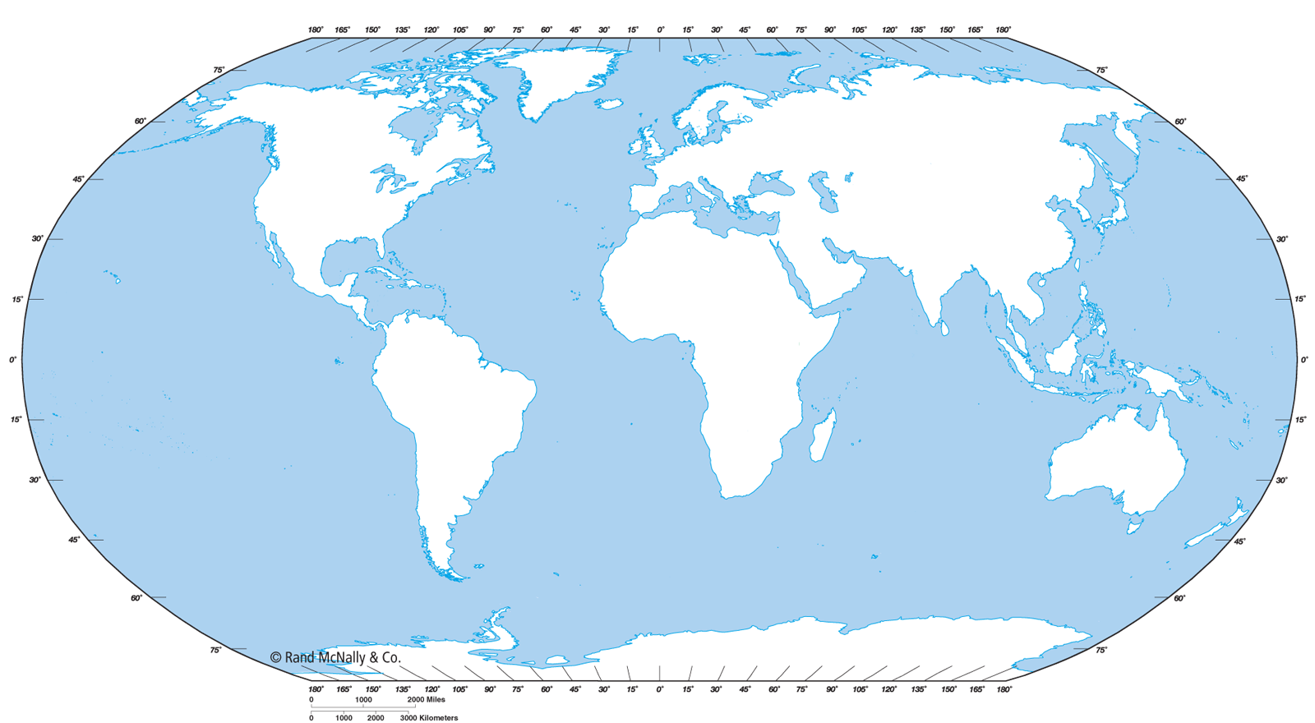
Iceland, UK, Scotland, Ireland

Slide 4
Iceland
Population: 325,000
GNI/capita (World Bank2013): $46,290
Annual population growth rate: 0.65%
People per square mile: 8
Not on the Renewable Energy Country Attractiveness Index (RECAI)! Probably too small to be attractive for investment

Slide 5


Slide 6
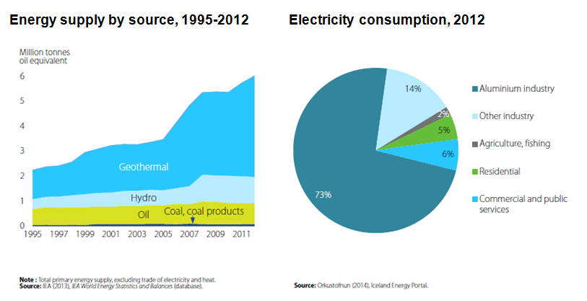
Energy vs Electricity

Slide 7
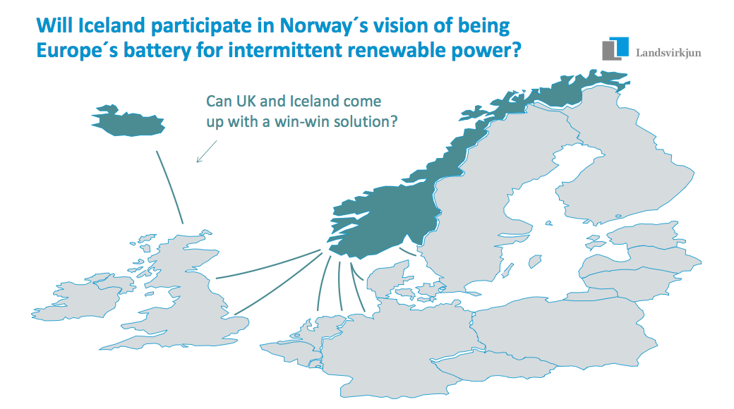
Export Green Electricity?

Slide 8
What about transportation?
The proportion of renewable energy Iceland is using in its fuel consumption in transport has risen tenfold since 2010, revealed recent data.
The report, based on the development of energy transition in transportation, was released by the Ministry of Industries and Innovation on Tuesday. It showed that the share of renewable transport fuel consumption has gone up by more than two percentage points since 2010 – from 0.2 per cent to 2.4 per cent – an increase that was much sharper than anticipated.

Slide 9
Meanwhile, there has also been a fivefold increase in the usage of domestic renewable transport fuels in the same period. Twenty-three per cent of renewable fuels used in transportation last year were produced in Iceland, with a number of new Icelandic companies starting to produce renewable fuels.
Furthermore, there has been a threefold increase in Iceland’s eco-friendly vehicles since 2010, with charging stations and methane refueling stations springing up across the country and making it easier for drivers to refuel on renewable energy.
http://www.icenews.is/2015/04/20/significant-rise-in-icelands-usage-of-renewable-transport-fuels/

Slide 10
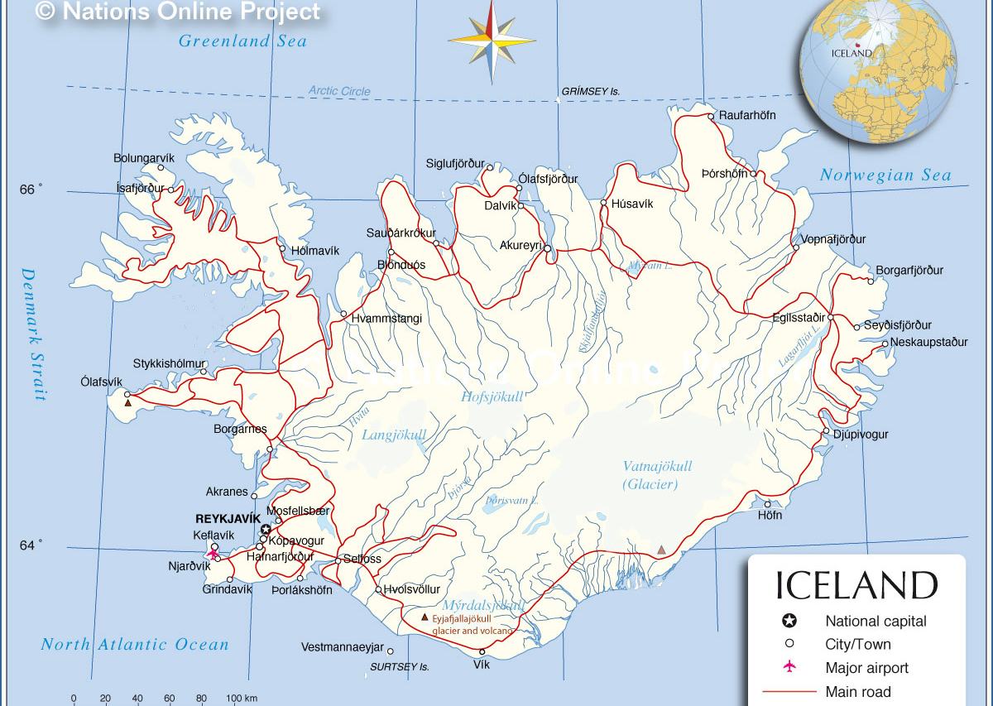

Slide 11
Iceland
Iceland Hot on Renewable Energy (video)
https://youtu.be/lWei4bgXf_k

Slide 12
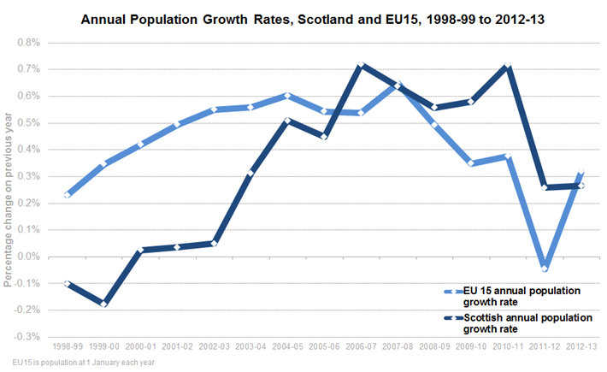
Scotland
Population: 5 million no RECAI (part of UK)
GNI/capita not available (part of UK)
50 people per square mile

Slide 13

100% Renewable Electricity by 2020
http://www.go100percent.org/cms/index.php?id=70&tx_ttnews%5Btt_news%5D=39

Slide 14
MeyGen tidal project
http://tidalenergytoday.com/2015/06/09/construction-progressing-well-at-meygen-site/
Situated in the Pentland Firth, the MeyGen tidal array will consist of 269 submerged tidal turbines, with 398 MW capacity, enough to power 175,000 Scottish homes.
https://youtu.be/rKaerhzGk5Y

Slide 15
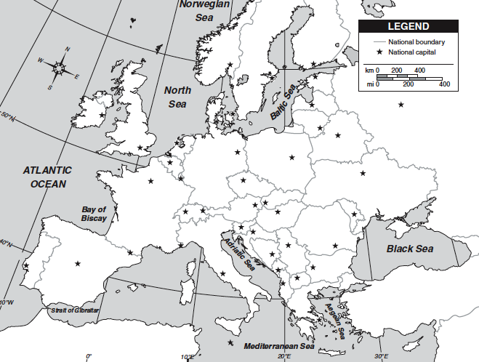

Slide 16
United Kingdom
Population: 60 million
GNI/capita (2013, World Bank): $41,680
Annual population growth rate: 0.54%
People per square mile: 660
Renewable Energy Country Attractiveness Index
RECAI Mar 2015
#1 OffShore wind energy attractiveness
#2 in Marine #1: Ireland
#5 Biomass #1-4: China, US, Japan, Brazil
#8 Onshore Wind #1-7: China, US, Germany, Canada, Brazil, India, Ireland
#10 Solar PV #1-9: China, US, Japan, Germany, India, Chile, Australia, France
#8 Overall

Slide 17

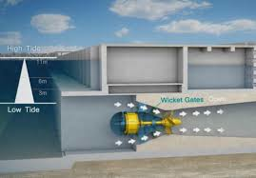

Swansea Bay Tidal Lagoon
http://www.tidallagoonswanseabay.com/the-project/film/107/

Slide 18
E-planes cross the Channel
The first powered flight across the Channel was achieved by Louis Blériot in his Blériot XI on July 25, 1909.
July 9 and 10, 2015 attempts at being the first electric plane to make the same flight were something of a flashback to those days, with no less than three competitors vying for the £1,000 (US$1,500) prize offered by the Daily Mail newspaper.

Slide 19
Of course, the money was mainly symbolic, since Airbus alone sunk £14 million (US$22 million) into its effort.
In addition, though the flight across the Channel may seem small compared to the ocean-spanning legs of the Solar Impulse 2 attempt, the channel jumpers are aiming for a more immediately practical form of electric flight that could see 100-passender electric hybrid planes entering service by 2030.

Slide 20
On July 10, the E-Fan took off from Lydd Airport with test pilot Didier Esteyne at the controls and flew 46 mi (74 km) to Calais in 36 minutes at an altitude of about 3,500 ft.
Built with an all-composite construction, the two-seater E-fan is 22 ft (6.7 m) long and has a wingspan of 31 ft (9.5 m).
From the outside, it almost looks like a toy jet aircraft with a pair of nacelles that aren't jets, but ducted, variable pitch fans.
These are spun by two electric motors powered by a series of 250 V lithium-ion polymer batteries. The ducting increases the thrust while reducing noise, and by centrally mounting them, the fans provide better control.

Slide 21
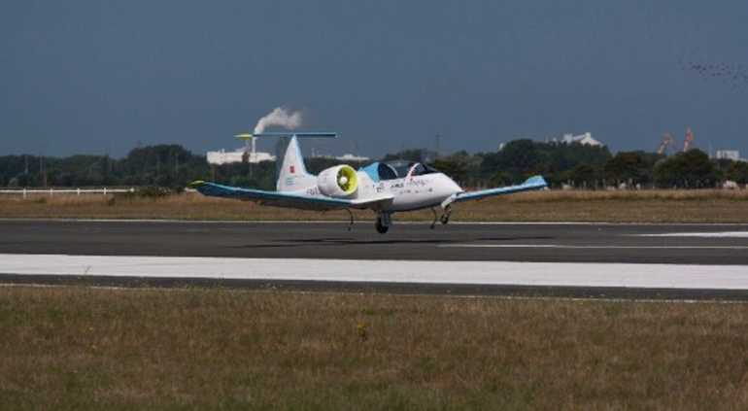
E-Fan

Slide 22
The E-Fan landed in Calais to considerable media attention, but the event went from congratulations to confusion as the Associated Press reported that Huges Duval had quietly taken off from Dover in his Cri Cri and had landed in Calais some 12 hours earlier on July 9! With a wingspan of about 16 ft (4.9 m) and two 35 bhp Electravia electric motors, the Cri Cri flew at 65 mph (105 km/h) and had a 25 min range.
According to AP, Duval's flight took only 17 minutes, which was shorter than the Airbus flight because the latter aircraft circled Lydd Airport after taking off while a helicopter carried out a visual safety check.
http://www.gizmag.com/first-electric-aircraft-cross-english-channel-airbus-cri-cri/38410/

Slide 23
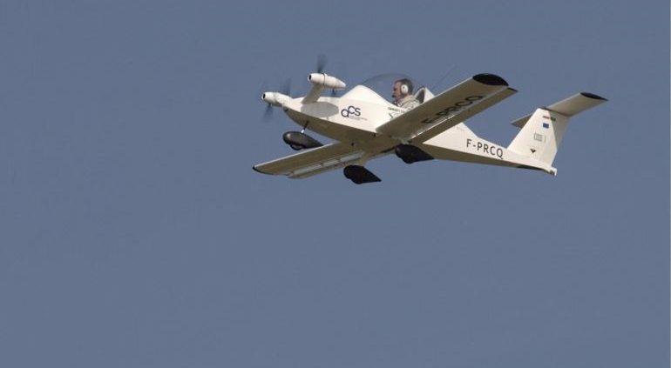
Cri Cri

Slide 24
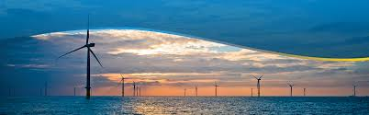
London Array
World’s Largest Off-Shore Wind Farm
https://youtu.be/ra6sogF4lLE
https://youtu.be/zaTNCUIX5WE

Slide 25
Ireland
Population: 5 million
GNI/capita: $43,090
Annual population growth rate: 1.20%
People per square mile: 168
RECAI Mar 2015
#1 Marine #2-7: UK, South Korea, Phillipines, France, Canada, Portugal
#7 Onshore Wind #1-6: China, US, Germany, Canada, Brazil, India
#30 Overall

Slide 26
Ireland
Micro-tidal
https://youtu.be/OCpBNQfpKDA
Onshore wind
http://www.iwea.com/windfarmsinireland

Slide 27
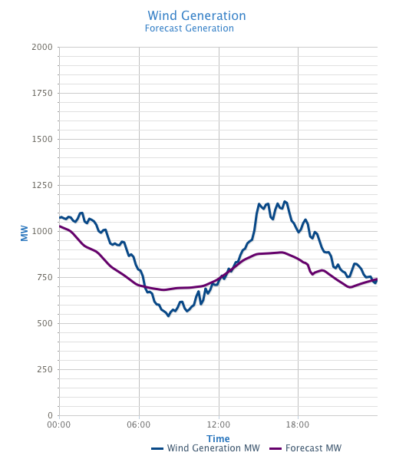
EirGrid
http://www.eirgrid.com/operations/systemperformancedata/windgeneration/

